Slide 1
INTELLIGENT BREAST CANCER DIAGNOSIS THROUGH DEEP LEARNING SEGMENTATION

Slide 2
ABSTRACT:
Breast cancer remains one of the most prevalent and deadly forms of cancer worldwide, necessitating innovative approaches for early detection and treatment. The advent of deep learning has revolutionized medical imaging, particularly in the field of breast cancer diagnosis. This research explores the application of deep learning techniques in breast cancer image processing and segmentation. Utilizing convolutional neural networks (CNNs), the study aims to enhance the accuracy and efficiency of identifying malignant tumors in ultrasound images and other breast imaging modalities. By leveraging large datasets and advanced image processing algorithms, deep learning models are trained to differentiate between healthy and cancerous tissues with high precision. This approach not only improves diagnostic capabilities but also aids in the segmentation of tumors, which is crucial for treatment planning and monitoring. The integration of deep learning in breast cancer detection holds significant promise for reducing false positives and negatives, ultimately contributing to better patient outcomes and personalized care.
Keywords: Breast cancer, Classification, Segmentation, Artificial intelligence (AI), Machine learning, Deep learning, Texture analysis, Shape analysis

Slide 3
EXISTING SYSTEM:
The incidence of breast cancer is increasing rapidly around the world. Accurate classification of the breast cancer subtype from hematoxylin and eosin images is the key to improve the precision of treatment. However, the high consistency of disease subtypes and uneven distribution of cancer cells seriously affect the performance of multi-classification methods. Furthermore, it is difficult to apply existing classification methods to multiple datasets. In this article, we propose a collaborative transfer network (CTransNet) for multi-classification of breast cancer histopathological images. CTransNet consists of a transfer learning backbone branch, a residual collaborative branch, and a feature fusion module. The transfer learning branch adopts the pre-trained DenseNet structure to extract image features from ImageNet. The residual branch extracts target features from pathological images in a collaborative manner. The feature fusion strategy of optimizing these two branches is used to train and fine-tune CTransNet. Experiments show that CTransNet achieves 98.29% classification accuracy on the public BreaKHis breast cancer dataset, exceeding the performance of state-of-the-art methods. Visual analysis is carried out under the guidance of oncologists. Based on the training parameters of the BreaKHis dataset, CTransNet achieves superior performance on other two public breast cancer datasets (breast-cancer-grade-ICT and ICIAR2018_BACH_Challenge), indicating that CTransNet has good generalization performance.

Slide 4
Drawbacks:
High Consistency of Disease Subtypes: The similarity between different subtypes of breast cancer can make it challenging to distinguish between them accurately.
Uneven Distribution of Cancer Cells: The irregular distribution of cancer cells in histopathological images can adversely impact the effectiveness of multi-classification methods.
Difficulty in Applying Existing Methods to Multiple Datasets: Existing classification methods often struggle to perform consistently across various datasets, limiting their generalizability.

Slide 5
INTRODUCTION:
Intelligent Breast Cancer Diagnosis through Deep Learning Segmentation using LeNet and U-Net Architecture** represents a significant advancement in medical imaging and artificial intelligence. Breast cancer is one of the most prevalent cancers among women globally, and early, accurate diagnosis is crucial for effective treatment and improved patient outcomes. Traditional diagnostic methods, such as ultrasound images, can be limited by human interpretation, variability, and the quality of imaging. Leveraging deep learning, particularly Convolutional Neural Networks (CNNs), offers the ability to automate and enhance the diagnostic process. In this context, LeNet and U-Net architectures are pivotal. LeNet, a pioneering CNN model, excels in image classification, while U-Net, a more advanced network, is tailored for image segmentation, making it ideal for identifying and isolating cancerous regions in medical images. By combining these architectures, the system can both detect (classify) and precisely locate (segment) tumor areas within breast tissue. This integration of deep learning techniques aims to assist radiologists, reduce false positives/negatives, and provide a faster, more accurate diagnostic tool for breast cancer screening and treatment planning. As a result, such intelligent diagnostic systems could revolutionize the healthcare industry, offering more reliable and consistent results in cancer detection and improving survival rates through early intervention.

Slide 6
PROPOSED SYSTEM:
The proposed system leverages advanced deep-learning techniques for the segmentation and detection of breast cancer from medical imaging data, specifically ultrasound images. This system integrates convolutional neural networks (CNNs) with sophisticated image processing algorithms to enhance the accuracy and efficiency of detecting malignant regions. The workflow begins with the acquisition of high-resolution ultrasound images, followed by preprocessing steps such as noise reduction, contrast enhancement, and normalization. These preprocessed images are then fed into a CNN-based segmentation model, which has been trained on a large dataset of annotated breast cancer images. The model identifies and segments potential cancerous regions, highlighting areas of concern for further analysis. Post-segmentation, a classification module evaluates the segmented regions to distinguish between benign and malignant tissues, providing a probability score for each region. The system's performance is continuously improved through iterative training and validation on diverse datasets, ensuring robustness and generalizability. Additionally, the integration of explainable AI techniques allows for the visualization of model decisions, enhancing transparency and aiding radiologists in their diagnostic process. The proposed system aims to significantly reduce the time and effort required for breast cancer detection, while increasing diagnostic accuracy and early detection rates, ultimately improving patient outcomes.

Slide 7
ADVANTAGES:
Increased Diagnostic Accuracy: By integrating CNNs and sophisticated image processing algorithms, the system significantly improves the accuracy of detecting malignant regions in ultrasound images, ensuring more reliable diagnoses.
Enhanced Early Detection Rates: The advanced segmentation and classification capabilities enable earlier identification of potential cancerous regions, leading to timely interventions and better patient outcomes.
Reduction in Diagnostic Time and Effort: The automated workflow streamlines the detection process, reducing the time and effort required by radiologists to analyze ultrasound images, thus increasing efficiency.
Minimized Human Error: The system's consistent and objective analysis minimizes the likelihood of human error, ensuring more precise and consistent diagnostic results.
Explainable AI for Improved Trust and Decision-Making: The integration of explainable AI techniques allows for the visualization of model decisions, enhancing transparency and helping radiologists understand and validate the system's outputs, which facilitates better clinical decision-making.

Slide 8
Review of Literature Survey
Title : Proposal of SVM Utility Kernel for Breast Cancer Survival Estimation
Author : Nikhilanand Arya , Archana Mathur , Snehanshu Saha, and Sriparna Saha
Year : 2023
The advancement of medical research in the field of cancer prognosis and diagnosis using various modalities has put oncologists under tremendous stress. The complexity and heterogeneity involved in multiple modalities and their significantly varied clinical outcomes make it difficult to analyze the disease and provide the correct treatment. Breast cancer is the major concern among all cancers worldwide, specifically for females. To help oncologists and cancer patients, research for breast cancer survival estimation has been proposed. It ranges from complex deep neural networks to simple and interpretable architectures. We propose a utility kernel for a support vector machine (SVM) in this article. It is a simple yet powerful function, which performs better than other popular machine learning algorithms and deep neural networks in the task of breast cancer survival prediction using the TCGA-BRCA dataset. This study validates the proposed utility kernel using four different modalities (gene expression, copy number variation, clinical, and histopathological tissue images) and their multi-modal combinations. The SVM based on our utility kernel empirically proves its efficacy by achieving the highest value on various performance measures, whereas advanced deep neural networks fail to train on small and highly imbalanced breast cancer data

Slide 9
Review of Literature Survey
Title : Recurrence Network Analysis of Histopathological Images for the Detection of Invasive Ductal Carcinoma in Breast Cancer
Author: Cheng-Bang Chen, Yujie Wang, Xuanya Fu, and Hui Yang
The histopathological image analysis is one of the most crucial diagnostic procedures to identify Invasive ductal carcinoma (IDC) in breast cancers. However, this diagnosis process is currently time-consuming and heavily dependent on human expertise. Prior research has shown that different degrees of tumors present various microstructures in the histopathological images. However, very little has been done to utilize spatial recurrence features of microstructures for identifying IDC. This paper presents a novel recurrence analysis methodology for automatic image-guided IDC detection. We first utilize wavelet decomposition to delineate the subtle information in the images. Then, we model the patches with a weighted recurrence network approach to characterize the recurrence patterns of the histopathological images. Finally, we develop automated IDC detection models leveraging machine learning methods with spatial recurrence features extracted. The developed recurrence analysis models successfully characterize the complex microstructures of histopathological images and achieve the IDC detection performances of at least AUC = 0.96. This research developed a spatial recurrence analysis methodology to effectively identify IDC regions in histopathological images for BC. It shows a high potential to assist physicians in the decision-making process. The proposed methodology can further be applicable to image processing for other medical or biological applications.

Slide 10
Aim:
The aim of the breast cancer classification and segmentation using artificial intelligence techniques is to develop and implement advanced machine learning and computer vision models that can accurately and efficiently assist in the diagnosis and characterization of breast cancer from medical imaging data. This includes the identification of malignant and benign tumors, tumor segmentation for precise localization, and the provision of valuable insights to medical professionals for early detection and treatment planning.

Slide 11
ENVIRONMENTAL REQUIREMENTS:
Software Requirements:
Operating System : Windows 10 or later
Tool : Anaconda with Jupyter Notebook, Pycharm
Hardware requirements:
Processor : Intel i3 or higher
Hard disk : minimum 10 GB
RAM : minimum 4 GB

Slide 12
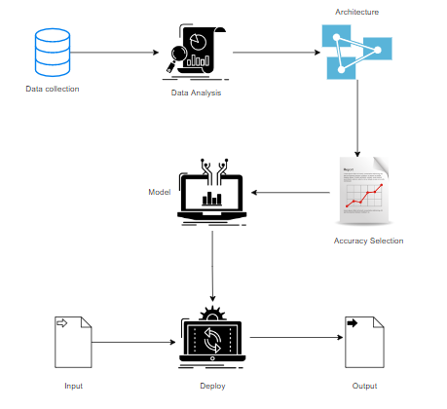
SYSTEM ARCHITECTURE:

Slide 13
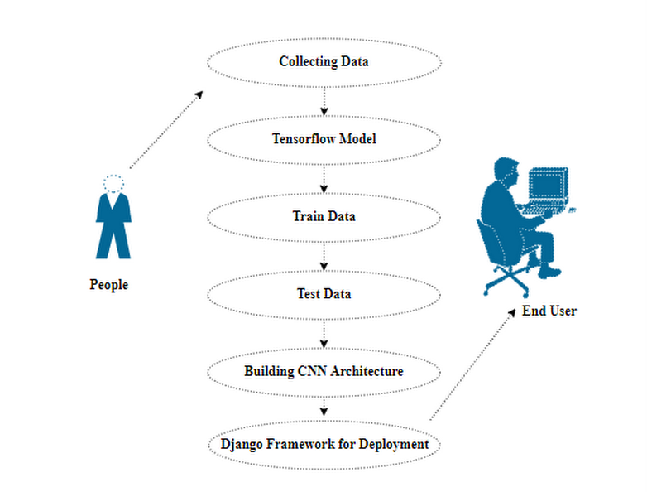
USECASE DIAGRAM:

Slide 14
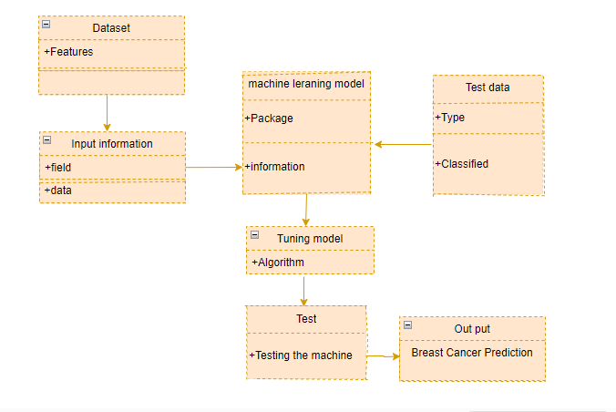
CLASS DIAGRAM:

Slide 15
LIST OF MODULES
1. Manual Architecture
2. LeNet Architecture
3. U-Net Architecture
4. Deployment

Slide 16
Data Analysis
1. Data analysis is the process of cleaning, changing, and processing raw data, and extracting actionable, relevant information that helps businesses make informed decisions. The procedure helps reduce the risks inherent in decision-making by providing useful insights. The data analysis process, or alternately, data analysis steps, involves gathering all the information, processing it, exploring the data, and using it to find patterns and other insights.

Slide 17
Manual Architecture :
Creating a manual architecture for image segmentation typically involves designing a neural network or algorithm that can process an input image and produce pixel-level segmentation masks or regions of interest. Here's a simplified manual architecture for image segmentation:
1. Input Image: The architecture takes an input image as its primary input. This can be a grayscale or color image depending on your application.
2. Preprocessing: Preprocess the input image to enhance features and reduce noise. Common preprocessing steps include resizing, normalization, and data augmentation.
3. Convolutional Neural Network (CNN): Use a convolutional neural network as the backbone of your segmentation architecture. CNNs are highly effective at capturing local patterns and spatial features in images.
- You can use a pre-trained CNN architecture like VGG, ResNet, or U-Net as a starting point, or design a custom architecture.
4. Encoder-Decoder Architecture: Many segmentation architectures follow an encoder-decoder structure:
- Encoder: The encoder part of the network extracts features from the input image through a series of convolutional layers. These layers reduce spatial dimensions

Slide 18
Le-Net Archietecture:
LeNet, short for "LeNet-5," is a classic convolutional neural network (CNN) architecture developed by Yann LeCun in the early 1990s. While LeNet is renowned for its role in image classification tasks, it can be adapted for image segmentation, including applications like breast cancer segmentation. Here's a high-level overview of how LeNet can be modified for this purpose:
1. Input Image: The input to the network is a breast cancer image, typically in grayscale or color, depending on your dataset and requirements.
2. Preprocessing: Preprocess the input images as needed. Common preprocessing steps include resizing to a consistent input size, normalization, and data augmentation.
3. LeNet Architecture: LeNet consists of a series of convolutional and pooling layers followed by fully connected layers. For breast cancer segmentation, you will need to modify the architecture to produce pixel-wise segmentation instead of classification.

Slide 19
U-Net Architecture:
The U-Net architecture is a popular deep learning architecture for image segmentation tasks, including breast cancer segmentation. It was originally developed for biomedical image segmentation and has since found applications in various medical image analysis tasks. The name "U-Net" is derived from the U-shaped architecture of the network.

Slide 20
Deployment
Deploying the model in Django Framework and predicting the output
In this module, the trained deep learning model is converted into a hierarchical data format file (.h5 file) which is then deployed in our Django framework for providing a better user interface and predicting the output of segmented Breast cancer image.

Slide 21
CONCLUSION:
In conclusion, the application of data science techniques in the classification and segmentation of malaria disease has proven to be a significant stride in the field of healthcare. The utilization of advanced algorithms and machine learning models has enabled accurate and efficient identification of malaria-infected cells in microscopic images. This breakthrough holds immense promise for early diagnosis and prompt treatment, ultimately contributing to a reduction in malaria-related morbidity and mortality.

Slide 22
FUTURE WORK:
Future work in breast cancer classification and segmentation should emphasize the incorporation of explainable AI techniques to enhance transparency and interpretability of model decisions, ensuring trust and acceptance in clinical settings.Exploring personalized medicine strategies by tailoring AI models to individual patient profiles and genetic variations can improve the accuracy of breast cancer diagnosis and treatment recommendations, paving the way for more targeted and effective healthcare interventions.

